Slide 1
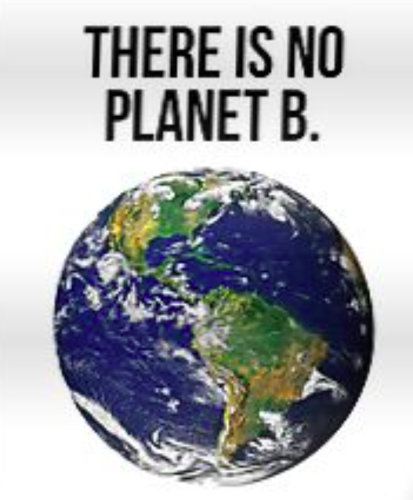
Las Cruceans Belief & Desire in Plastic World is Out of Touch with Reality
David M. Boje
Regents Professor, New Mexico State University

Slide 2
Las Cruceans Ignore these Facts
We need 1.7 Planet Earths to keep up with our Production & Consumption Habits, but THERE IS NOT PLANET B
2.12 billion tons of Waste each year, enough to fill a circle of garbage trucks 24 times
99% of everything you buy is Trash within 6 months
By 2050 more plastic in ocean than weight of all the marine life
It takes thousands of years for a plastic milk jug to decompose, a century for a single-use plastic soda or water bottle
300 million tons of plastic produced each year and only 2% goes into recycling, & only once, then its all waste accumulation, that never goes away

Slide 3
Facts for Las Cruceans to Ponder
Worldwide 500 billion plastic bags produced a year, consumed at rate of 1 million per minute
14 Billion pounds of trash enter Oceans every year
50% of all plastic produced is used only once, and tossed; only 5% is ever recycled
Average American tosses 185 pounds of plastic each year
1 Million Sea Birds & 100,000 Marine Mammals killed by Plastic in world’s oceans
The Nanoplastic particles in just one Plastic Water Bottle break down, to potentially reach every mile of beach on Planet Earth
93% of Americans above age 6, have BPA contamination from plastic in their body
12 Hormone altering chemical toxins are absorbed in microplastic lint, microbeads, and in those tiny nanoplastic particles (so mall they penetrate the deepest into lungs, liver, kidney, and can enter every molecule in the human body).

Slide 4
Electronic Waste is Fastest Growing Waste Stream in the World
E-Waste contains TOXIC Heavy Metals & Nanoplastic that Poisons People, Animals, Plants, Soil…
EXPERIMENT: GPS tracking devices placed in recycled 200 computers/printers/monitors (E-Waste), dropped in E-recycling at GOODWILL (Dell’s partner) wound up in 3rd World ‘recycling’ villages in China, Hong Kong, & Taiwan. See YouTube
Notes:
https://www.youtube.com/watch?v=n6FJJ29k8uc

Slide 5
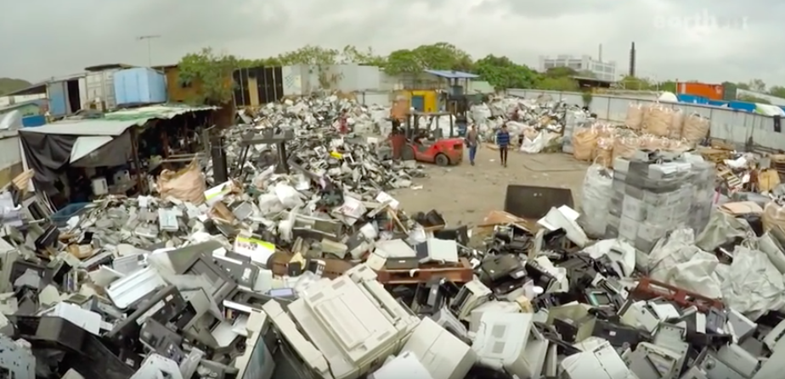
ANTENARRATIVE of Working Conditions (no glovers or masks) and no training in Hazardous Waste Recycling
Track the E-Waste using GPS from US recycling facilities to 3rd World village E-waste recyclers (unlicensed & unregulated); For the ANTENARRATIVE PROCESS look for the asset tags on printers/computers/monitors/laptops of US institutions, universities, prisons… Tiny amounts of lead, mercury from LCD tubes, carcinogens from printer toner, etc.

Slide 6
USA is ONLY nation not ratifying international “BASEL CONVENTION ON INTERNATIONAL WASTE” treaty to stop 1st world nations from shipping e-waste to 3rd world nations
Source Average US household owns 28 e-goods
US generates 3.14 million tons of E-waste yearly
Only 16% of World’s E-waste is recycled by companies or agencies sanctioned by regulators
The US EPA exempts E-waste as ‘non-hazardous’ despite the lead-lined cathode ray tubes, the mercury, and other heavy metals.
22 States, including NEW MEXICO have not passed E-waste laws (source).
By Signing the BASEL CONVENTION ON INTERNATIONAL WASTE, US manufacturers would pay for E-waste recycling processing in safe working conditions, with trained workers.
It takes hundreds of trained workers for computer companies such as Apple, Dell, HP, Sony, etc. to do Hazardous-Waste Recycling.
Notes:
https://eridirect.com/blog/2015/07/its-2015-which-states-have-e-waste-legislation/
http://www.basel.int/TheConvention/Overview/History/Overview/tabid/3405/Default.aspx

Slide 7
True Storytelling Las Cruceans’ Plastic Addiction
> 10 Major Cities in US have Zero Waste Strategic Implementation plans by 2020 through 2050
Austin TX by 2040; and Dalla
Minneapolis 80% by 2020
NYC 90% by 2030
Seattle 72% by 2020
In CA, there is San Francisco, Oakland, Berkeley, LA, and San Diego
BUT NO LAS CRUCEAN Zero Waste Strategy Implementation

Slide 8
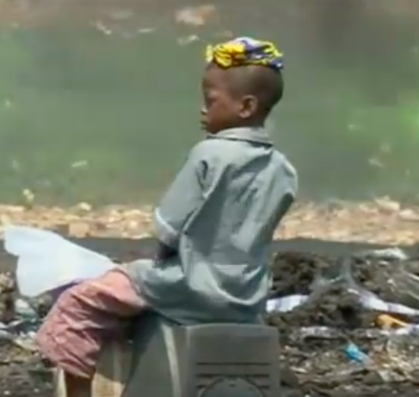
E-Waste Storytelling
We are told the GRAND NARRATIVE by our Computer/Printer Manufacturers that our E-Waste is being safely Recycled
Children as young as 5 in Ghana burn the E-waste to get to the copper for recycling. They are affected by poisonous fumes creating lung cancer, poisoning water & soil
See E-Waste Hell in Africa YouTube

Slide 9
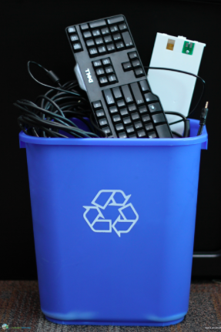
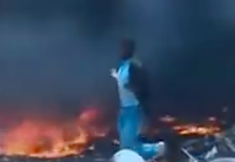
E-Recycling ‘Dis-Place-Ment’ Becomes Phantasm
1st World E-waste ➔3rd World for Unhealthy Recycling ➔ Recycled commodity materials back to 1st World for more E-producing and E-consuming
This DIS-PLACE-MENT in perpetual exploitation process that is Not HEALTHY, HAPPY, or TERRIFIC
Therefore we need an “Archaeology of Narrative” of the computer/printer manufacturers (Deleuze, 1990: 39)
Please put GPS tracking device on our University E-Waste
DIS-PLACE-MENT announces a FUTURE

Slide 10
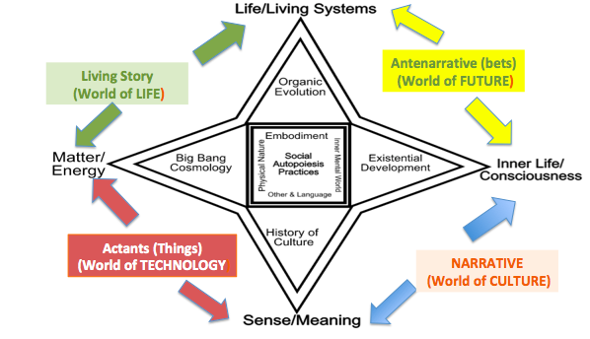
Untold Living Story of UN-Healthy, UN-Happy & UN-Terrific
HIDDEN COSTS
E-Waste Mishandling
Plastic Waste

Slide 11
THE TINA NARRATIVE of World of US CULTURE:
“There Is No Alternative” to plastic & E-Waste life style (TINA NARRATIVE)
Has a Counternarrative: Zero Waster (& Zero Plastic) are the Alternative to Plastic Addiction
LAS CRUCEANS have only the TINA NARRATIVE and no Zero Waste Strategy, and no Zero E-waste Strategic Implementation

Slide 12
A-B-C-D Propositions of Las Cruceans in Plastic New Mexico
PROPOSITION A = “Plastic is everywhere”
PROPOSITION B = “We cannot live without the many plastic benefits”
PROPOSITION C = “There Is No Alternative” to plastic life style (TINA NARRATIVE)
PROPOSITION D = “If A-B-C are True”, then “so on to infinity” (Deleuze, 1994 Logic of Sense: 16, italics, mine)

Slide 13
SOCIOECONOMIC INNOVATION PROJECTS for Small Businesses
Las Cruceans – Let’s have Zero Waste INNOVATION PROJECTS!
Find amazing alternatives to Plastic
Diagnose the HIDDEN COSTS of Plastic Life Style
Reduce the PLASTIC DYSFUNCTIONS by focusing on ZERO WASTE product development
1st begin with psycho-sociological STUDY OF THE LAS CRUCEAN,
2nd organize DPIE (Diagnosis, Project, Implementation, Evaluation) groups horizontally (top executives) and bottom up (vertically)
3rd Plenary Group meetings of all, every few weeks
4th put it together in a TABLE of Financial Consequences for NEXT MIRROR EFFECT

Slide 14
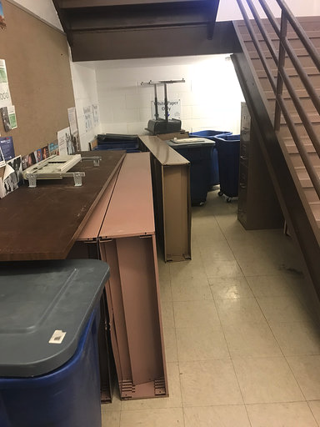
The Chaos of Recycling in College of Business BUSINESS COMPLEX BUILDING 1st floor behind stairwell where no one can get at it
BUT IS THE ‘REAL’ PROBLEM THE MICROPLASTIC, microbeads size of grain of sand, microfiber plastics size of hair, or the INVISIBLE nanoplastic particles?

Slide 15
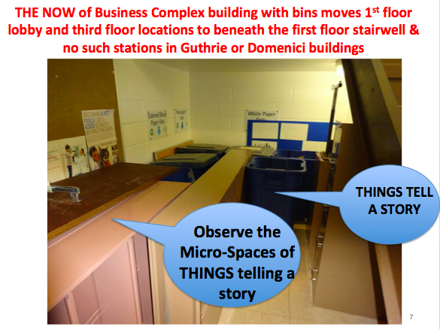

Slide 16
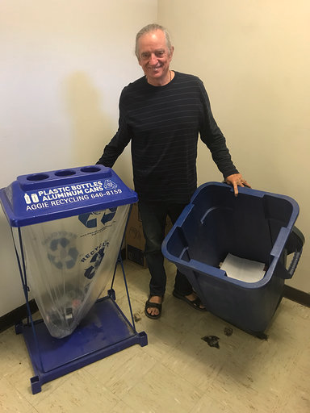
NMSU is NOT catching the invisible NANOPLASTIC, or the barely visible microfiber plastics, or the microbeads of plastic & nylon, or E-Waste in its recycling STRATEGIC IMPLEMENTATION
Photo of BUSINESS COLLEGE ‘Guthrie Hall recycling station, hidden where few can find it, and no NANOPLACTIC and No E-Waste intervention here
Why No E-Waste Container Anywhere at NMSU?

Slide 17
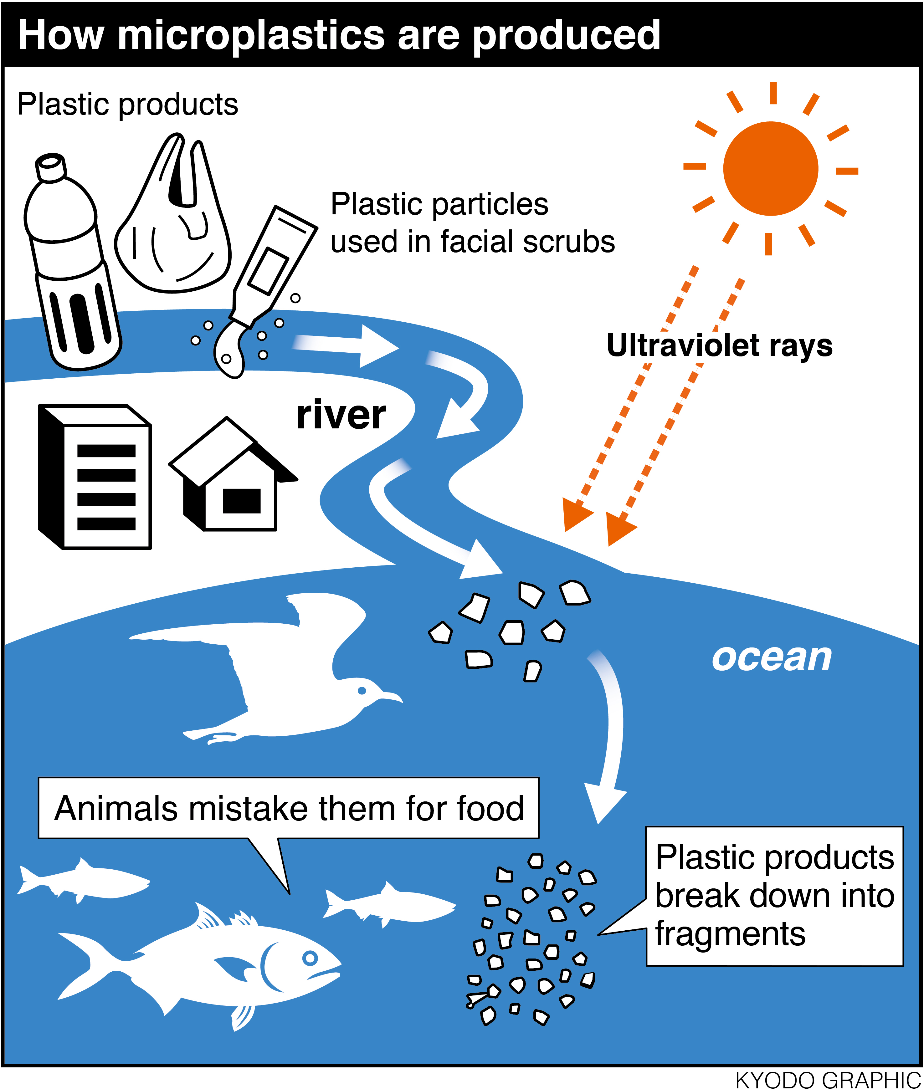

Slide 18
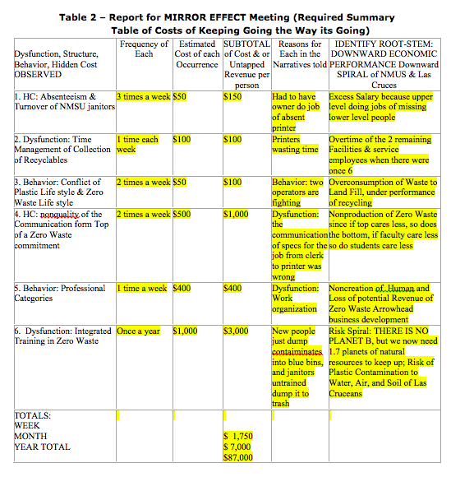

Slide 19
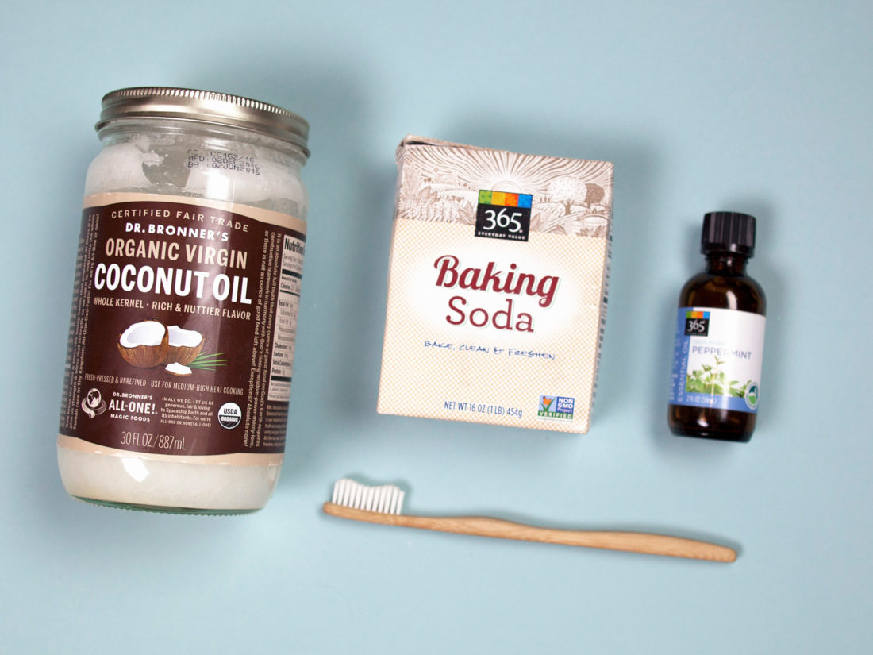
Make your own Zero Waste Toothpaste BUSINESS IDEA
Recipe
¼ cup coconut Oil
1-2 Tb Baking Soda
½ Tb Stevia or Xylitol (for taste)
5-10 drops Peppermint Oil
2-3 Teaspoons activated charcoal (optional)
You can just mix it or heat up in double boiler (optional)
POUR IT INTO SMALL BOTTLE because the Toothpaste tubes are plastic that is so very wasteful
https://youtu.be/DIpTXQl7qT0 and Buy your very own Bamboo Toothbrush because the plastic ones are so very wasteful

Slide 20
Make Zero Waste SHAMPOO BUSINESS IDEA
Ingredients (https://zerowastenerd.com/homemade-dry-shampoo)
2 tb Organic Cornstarch
2 tb Cocoa Powder or Cinnamon, or none (depending on your hair color)
Instructions
Mix both ingredients together so that they are fully mixed.
Apply to the roots of your hair with an old spice jar or use a powder brush.
Let powder set for about 5 minutes then massage into your scalp.
Brush through with a comb and you're all set to skip washing for another day!
Recipe Notes
For blonde hair, omit the cocoa powder.
For auburn to red hair, try using cinnamon or paprika instead of cocoa powder or mix the two to find your perfect shade.
For darker brown to black hair, use more cocoa powder.

Slide 21
Make Aloe Vera Hair Conditioner BUSINESS IDEA
How to make your own Zero-Waste Conditioner? YouTube https://www.youtube.com/watch?v=udE58-uOdpY
Conditioner with Aloe Vera instead of conditioners full of sulfates or plastics that are not great for hair. Note: It does not bubble up, but bubbles don’t matter!
Aloe Vera is base instead of water (great hair protein). Bentonite Clay (buy in bulk) acts as sponge to soak up toxins from hair & scalp.
Petri Oil
Rose Absolute Oil (moisturizers)
Chop Stick to mix (do not mix with metal stirrer due to electric charge)
Instructions
Cut Aloe Vera with knife; cut sides off to open it up,
Separate the skin off to leave the thick gel
Scape up the gel with a metal spoon onto wood cutting board
Liquefy the gel in a blender
Put it into glass or metal or wood container, and add Tb of the Bensonite clay, and 10 drops Petri Oil, and 10 drops of Rose Absolute (smells amazing)

Slide 22
Zero Waste Deodorant BUSINESS IDEA
½ cup Coconut Oil
¼ cup Shea Butter (or ¼ cup Cornstarch; or Arrowroot)
¼ cup Baking Soda
10 Drops Lavender Oil &/or
10 drops Lemongrass Oil (or Essential Oil)
On LOW FLAME, Melt Shea and Coconut oils and Shea Butter and mix well, then add Baking Soda, as you mix, and finally add oils of choice.

Slide 23
Zero Waste Shaving Cream BUSINESS IDEA
First, Buy a steel safety razor
Recipe:
½ cup Shea Butter
½ cup Coconut Oil
¼ cup Aloe Vera
10 Drops Lavender Oil &/or Lemongrass Oil (or Essential Oil)
Instructions: ON LOW FLAME, use double boiler (bowl top of pan of simmering water) until ingredients melt, and then stain for lumps from Aloe Vera plant; Refrigerate, then use mixer or hand mix to whip up the shaving cream into fluffy peaks.

Slide 24
Are Microbeads of Plastic Polluting New Mexico’s Rio Grande?
Las Cruceans need to ask this question:

Slide 25
TRUE STORYTELLING
ACADEMY
Method
Projects
About
Contact
Consulting
Education
Reach your goals
with the 7 principles
in True Storytelling
Book next
TS Boot Camp
Truestorytelling.org

Slide 26
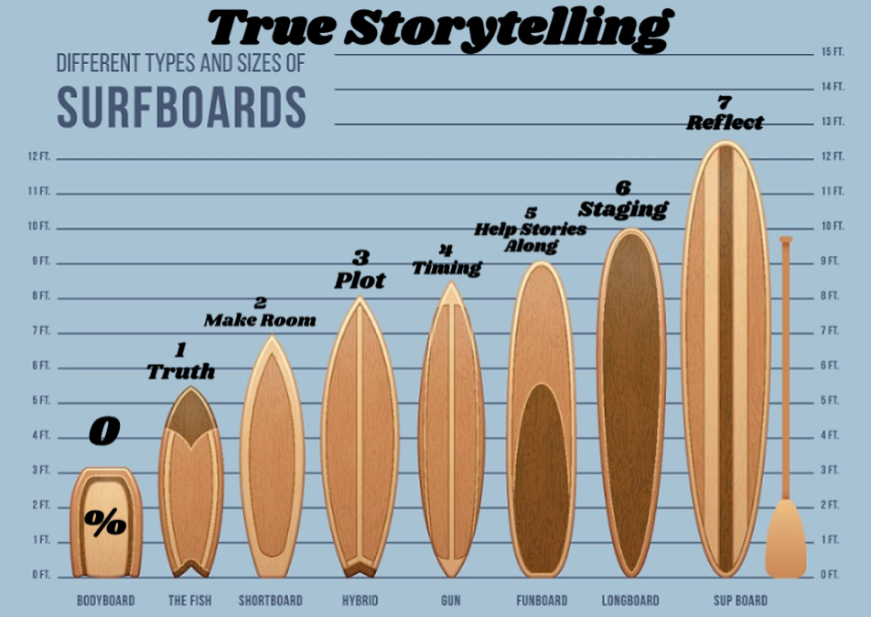
Truestorytelling.org

Slide 27
SCIENCE OF Microplastics, Microbeads, Microplastic fibers, and Nanoplastic particles in Lakes and Rivers
All the plastic every produced is still present on/in the Earth, in Rivers and Lakes:
Baldwin, A. K., Corsi, S. R., & Mason, S. A. (2016). Plastic debris in 29 Great Lakes tributaries: relations to watershed attributes and hydrology. Environmental science & technology, 50(19), 10377-10385. https://pubs.acs.org/doi/full/10.1021/acs.est.6b02917
Eriksen, M., Mason, S., Wilson, S., Box, C., Zellers, A., Edwards, W., ... & Amato, S. (2013). Microplastic pollution in the surface waters of the Laurentian Great Lakes. Marine pollution bulletin, 77(1-2), 177-182. http://wedocs.unep.org/bitstream/handle/20.500.11822/17932/Microplastic_pollution_in_the_surface_waters_o.pdf?sequence=1&isAllowed=y
Free, C. M., Jensen, O. P., Mason, S. A., Eriksen, M., Williamson, N. J., & Boldgiv, B. (2014). High-levels of microplastic pollution in a large, remote, mountain lake. Marine pollution bulletin, 85(1), 156-163. http://home.fredonia.edu/sites/default/files/section/earth/PDF/High-levels%20of%20microplastic%20pollution%20in%20a%20large%2C%20remote%2C%20mountain%20lake.pdf
Graney, G. (2015). Slipping through the cracks: how tiny plastic microbeads are currently escaping water treatment plants and international pollution regulation. Fordham Int'l LJ, 39, 1023. https://heinonline.org/hol-cgi-bin/get_pdf.cgi?handle=hein.journals/frdint39&section=29&casa_token=ymmuCQr_5VsAAAAA:R95bTp98eoOv2Aun-GXMTeGrQhSpobBkCJndA8EPBcRdk5Z76OOLv53WpgcU_kvQkBLdmeJR5g
Mazurais, D., Ernande, B., Quazuguel, P., Severe, A., Huelvan, C., Madec, L., ... & Zambonino-Infante, J. (2015). Evaluation of the impact of polyethylene microbeads ingestion in European sea bass (Dicentrarchus labrax) larvae. Marine environmental research, 112, 78-85. http://archimer.ifremer.fr/doc/00279/39057/37621.pdf
Sruthy, S., & Ramasamy, E. V. (2017). Microplastic pollution in Vembanad Lake, Kerala, India: the first report of microplastics in lake and estuarine sediments in India. Environmental pollution, 222, 315-322. https://www.researchgate.net/profile/Shini_Sruthy/publication/312222906_Microplastic_pollution_in_Vembanad_Lake_Kerala_India_The_first_report_of_microplastics_in_lake_and_estuarine_sediments_in_India/links/5af164e1aca272bf4255b7ca/Microplastic-pollution-in-Vembanad-Lake-Kerala-India-The-first-report-of-microplastics-in-lake-and-estuarine-sediments-in-India.pdf
Zhang, K., Xiong, X., Hu, H., Wu, C., Bi, Y., Wu, Y., ... & Liu, J. (2017). Occurrence and characteristics of microplastic pollution in Xiangxi Bay of Three Gorges Reservoir, China. Environmental Science & Technology, 51(7), 3794-3801.

Slide 28
With the strong science evidence, came the push for legislation and the Plastic & Chemical industry backlash
By 2018, the world was on track to eliminate microbeads from ‘rinse-off’ products within a decade, reducing microplastics flowing into oceans by 1–2%. This confirms the power of environmental norms, but how and why this phaseout is occurring – unequally across jurisdictions, with firms creating loopholes, missing deadlines and limiting the scope of reforms – also reveals innate weaknesses of bottom-up, ad hoc norm diffusion as a way of improving marine governance. These weaknesses are heightened when economic stakes are high, solutions are complex and costly, authority is fragmented across jurisdictions and corporate resistance is strong.
Dauvergne, P. (2018). The power of environmental norms: marine plastic pollution and the politics of microbeads. Environmental Politics, 27(4), 579-597. https://www.tandfonline.com/doi/full/10.1080/09644016.2018.1449090?casa_token=BVL7PLRvfkEAAAAA:VJJhPBWyyk1UO7mHkflU63yUoEVnB7QBiL_GEIgRJuwcy8eMI2ncXRwdR3b7tTJ0_oW1pCtcgv0Z

Slide 29
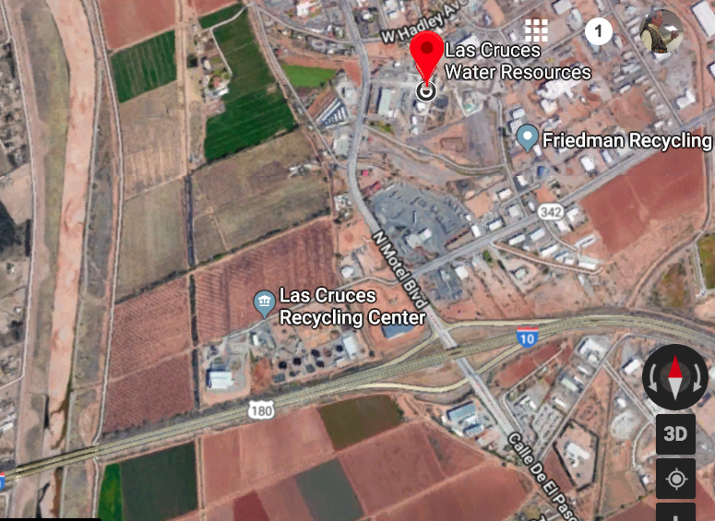
← RIO GRANDE RIVER

Slide 30
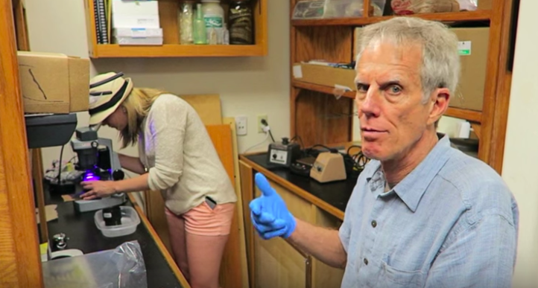
Science of How to Study Microplastic in our Rivers, Lakes, Oceans
https://www.youtube.com/watch?v=FJ36Gt6Rn0k

Slide 31
Question: Are there microbeads passing through Las Cruces Water Treatment plant into Rio Grande?
I am searching for "microbeads," bits of plastic no bigger than salt grains that absorb toxins such as motor oil, DDT, PCB, Cleaning solvents, and insecticides as they tumble downstream from the Las Cruces Water Treatment Plant and the Las Cruces Recycling facility, and then into the Rio Grande River.

Slide 32
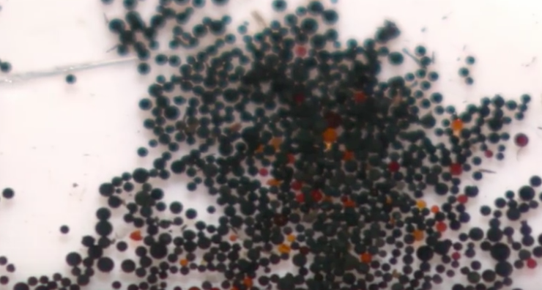
Does Rio Grande River have microbeads pollution
We shall look for this

Slide 33
St. Lawrence River https://www.youtube.com/watch?v=JkQp_uNC6mk
The tiny polyethylene and polypropylene microbeads are an emerging concern among the world’s scientists and environmentalists. The plastic microbeads come mostly from personal care products such as facial exfoliants and body washes

Slide 34
Types of Analysis Citizen Scientists doing on Rivers in Italy
https://www.youtube.com/watch?v=ZegpDbhG9AY
Chemical reagents to measure nitrate and phosphate concentrations
Visual analysis of clarity of the water
It goes into a Citizen Scientist app
3. There are lab tests in Italy of the size, weight, & type of microplastic, plastic microbeads, and microfibers from polyester in the rivers
4. Lab tests of Microcosm tests on aquatic life changes from micro plastic in the ecosystem of the rivers

Slide 35
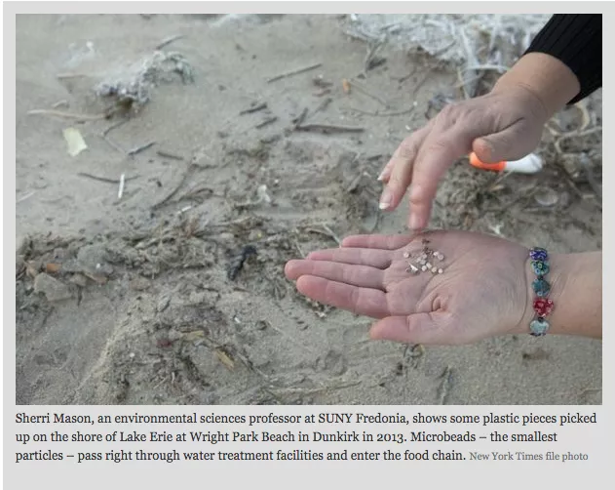

Slide 36
Industry’s countermeasures
Reduction of microbeads has not occurred evenly across jurisdictions, firms or products
Industry has further lobbied for legislation that would allow biodegradable microplastics (Rochman et al. 2015b Rochman, C.M., et al. 2015b… while concurrently arguing that microbeads, which comprise a ‘tiny’ portion of plastic pollution, were being unfairly demonized because of their visibility in consumer products (Personal Care Products Council et al. 2017 Personal Care Products Council (PCPC), et al., 2017. Global cosmetics and personal care industry addresses plastic pollution in oceans. 5 June. Available from:
http://www.personalcarecouncil.org/newsroom/personalcareindustry-addresses-plastic-pollution
).
SOURCE: Dauvergne, P. (2018). The power of environmental norms: marine plastic pollution and the politics of microbeads. Environmental Politics, 27(4), 579-597. https://www.tandfonline.com/doi/full/10.1080/09644016.2018.1449090?casa_token=BVL7PLRvfkEAAAAA:VJJhPBWyyk1UO7mHkflU63yUoEVnB7QBiL_GEIgRJuwcy8eMI2ncXRwdR3b7tTJ0_oW1pCtcgv0Z

Slide 37
Students in Florida doing Field Research in Imperial Rivers
https://www.youtube.com/watch?v=Sip2Ckaouyw
Imperial River fish mistake microplastics for food
Fish and shellfish absorb microplastic pollution
Some river beaches have banned plastic straws that breakdown into microplastic

Slide 38
Microplastics in Saint John’s Ortega River
https://www.youtube.com/watch?v=qcJkQ8ZntKw
Found 39 microplastic fibers of nylon and polyester unfiled by the water treatment plant
Students show Petri dish of microbeads collected from river samples
8 trillion microbeads enter waterways everyday.

Slide 39
States taking action or NOT
These states have passed laws restricting microbeads, including Colorado, Illinois, Indiana, Maine, Maryland, New Jersey, and California.
New Mexico has not passed laws restricting microbeads of plastics in toothpaste, facial scrubs, and cosmetics.

